Slide 1
Your trip to
Château de la Baudonnière

Slide 2
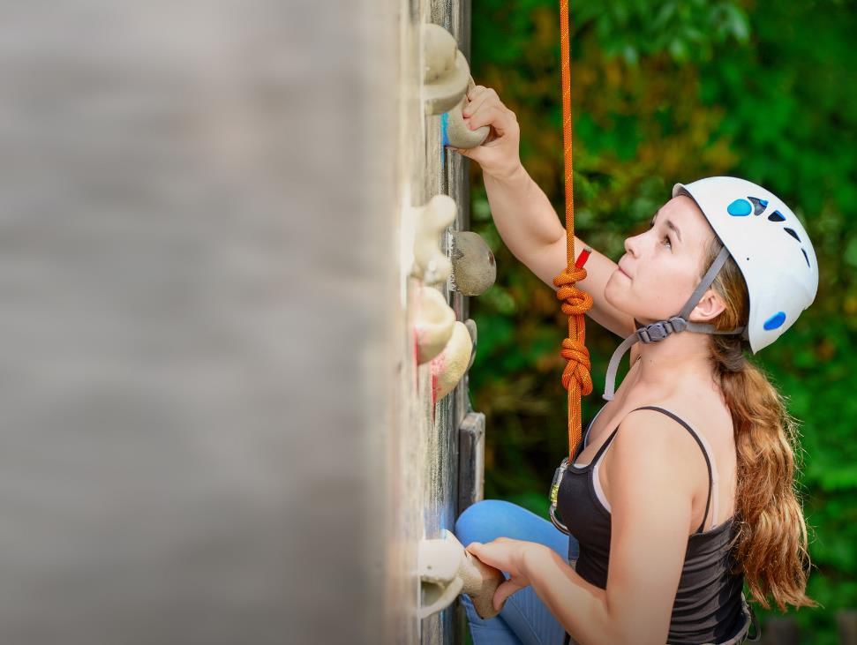
We help students reach new heights
Château de la Baudonnière specialises in language immersion educational school trips where students can learn, thrive and achieve their potential outside the classroom.
We believe that every school trip should provide students with new experiences, learning activities and exposure to local culture with genuine educational benefit.

Slide 3

You’re in safe hands
Your group’s safety is our priority
All our animateurs hold UK-accredited instructor qualifications for climbing, fencing, archery, first aid and lifeguarding
More adventurous activities, such as kayaking, are supervised by professional sports instructors working beside our animateurs
Château de la Baudonnière is authorised to accommodate school groups by the French Ministry of Youth and Sport and accredited by the French Ministry of Education

Slide 4


The flexibility you need
^{Receive a full refund}
If your trip is cancelled within 21 days of departure due to COVID-19 restrictions and you are unable to claim from your insurance, we guarantee to either find you a suitable alternative or refund your group in full in the event:
The DfE or FCDO advise against travel to your destination
Local or national UK lockdowns prevent your departure
The whole group is required to quarantine upon arrival
Government travel rules require your whole group to quarantine on your return
We understand parents may be worried about being left in the lurch or out of pocket because of changing travel rules.
That’s why we’ve enacted our Peace of Mind Promise, which gives you extra financial protection in the event:
DfE or FCDO advise against travel
Quarantine restrictions are imposed
Find full details at
the-chateau.com/covid-19-travel-hub/
^{Freedom to postpone}
If you have to change your plans because of COVID-19, we promise to waive our amendment fees so that you can postpone your trip between 12 weeks and 28 days before departure.

Slide 5
Welcome to
the Château!
Everything at the Château will be conducted in French, from the activities to mealtimes, and there’s always an emphasis on trying your best and having fun!
With so many fantastic facilities on site, you’ll enjoy a jam-packed programme of language-based physical activities

Slide 6
Meet your animateur
Upon your arrival you’ll meet your animateur!
Our specially trained French native animateurs will be speaking with and encouraging interactive responses from you throughout your stay to challenge you and improve your language skills

Slide 7
Food
& dining
Your stay at the Château is full board, which means you'll enjoy a seasonal menu of home-cooked meals tailored to students' tastes while maintaining a French flare
Our skilled chefs are experienced in catering to any special dietary requirements your group may have

Slide 8
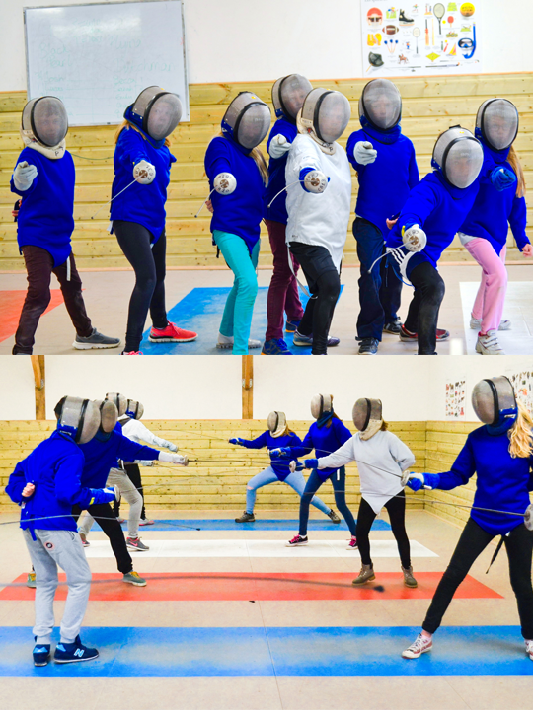
Fencing

Slide 9
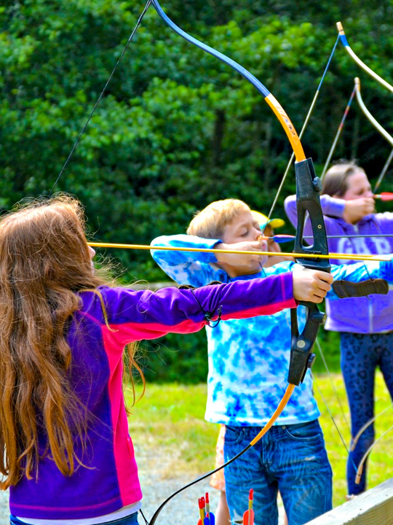
Archery

Slide 10
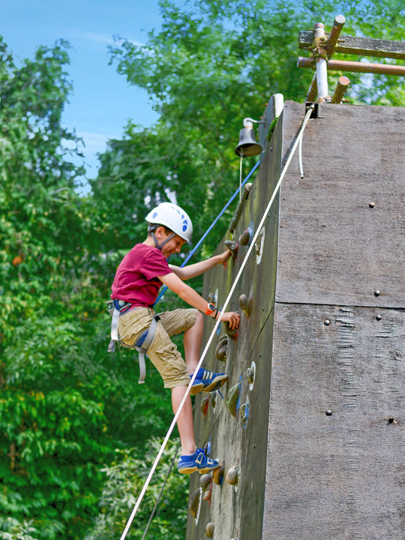
Climbing wall

Slide 11
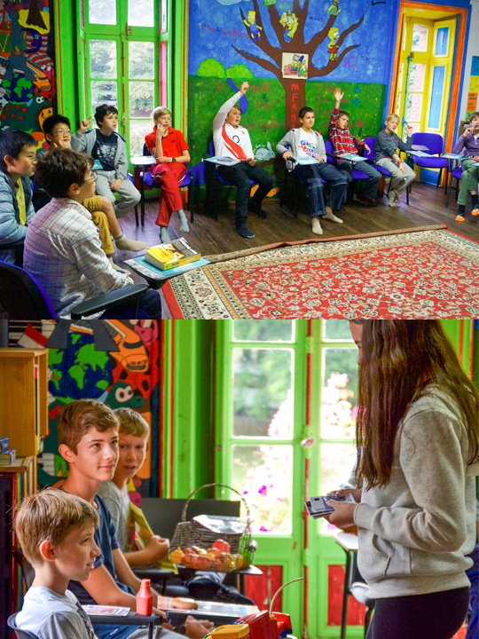
French lessons

Slide 12
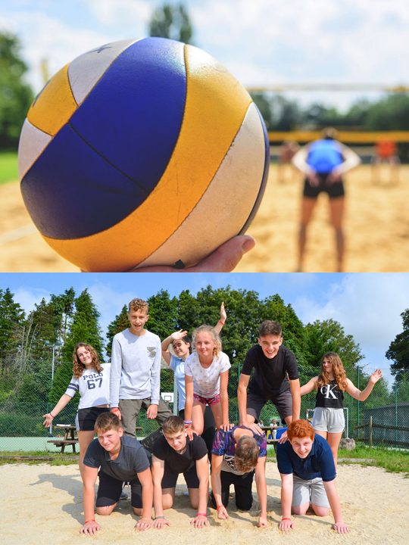
Volleyball

Slide 13
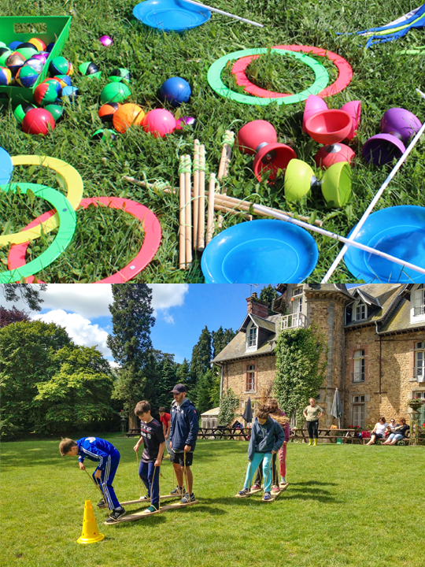
Circus skills

Slide 14
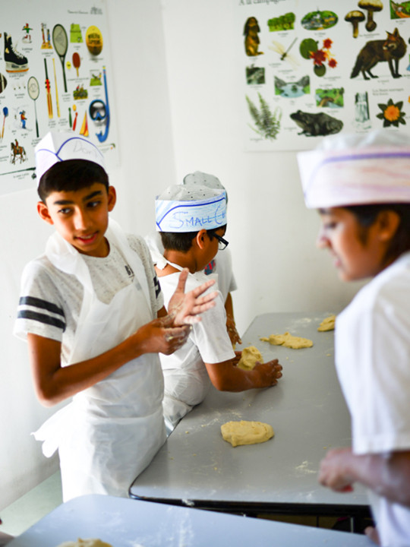
Bread
making
Don your chef’s hat and unleash your inner baker.
During this activity you’ll learn vocabulary relating to weights and measurements as you follow the recipe. You’ll also enjoy a French singalong!
Try your best to follow the recipe because you’ll be enjoying the fruits of your labour later on.

Slide 15
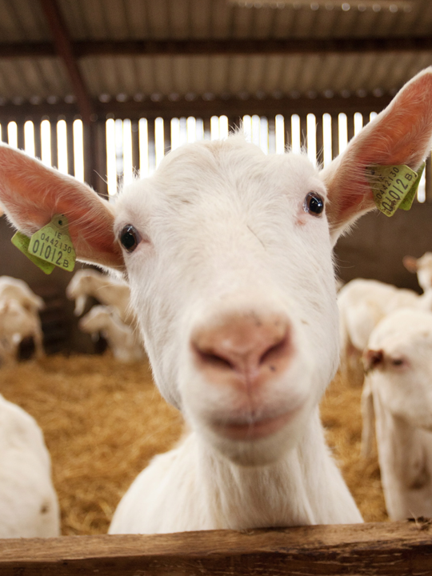
Goat cheese farm
An interactive visit of a local working goat farm and cheese producer (or similar alternative) Includes the all important tasting of the famous Normandy produce

Slide 16
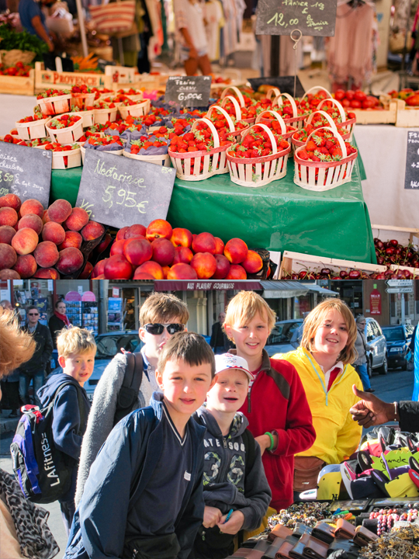
Market
mission
Visit a local market with your animateur
Teams of students will be given money to buy ingredients for a packed lunch and you will also have some general shopping time
Return to your accommodation where your animateur will organise a competition for the best lunch

Slide 17

Mont Saint-Michel
Mont Saint-Michel and its bay are part of the UNESCO list of World Heritage Sites and more than 3 million people visit it each year. Visit the Abbey, Monastery, Great Halls and shops and village housing
Outside the walls, there are fishermen and farmer houses

Slide 18
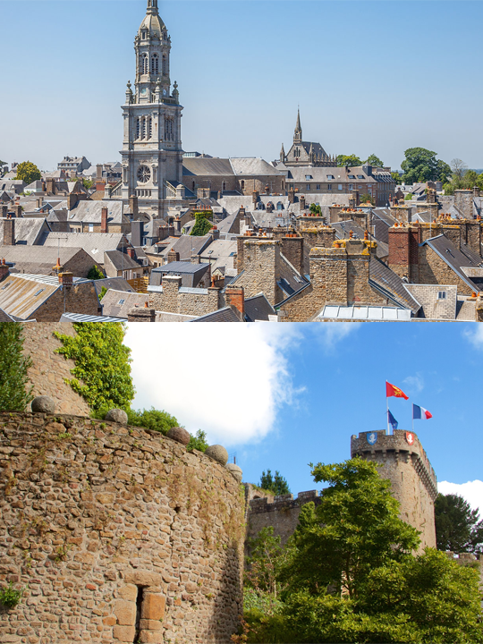
Avranches town trail
Your animateur organises this activity with our tailor made Town Trail requiring the students to read, understand and speak French

Slide 19
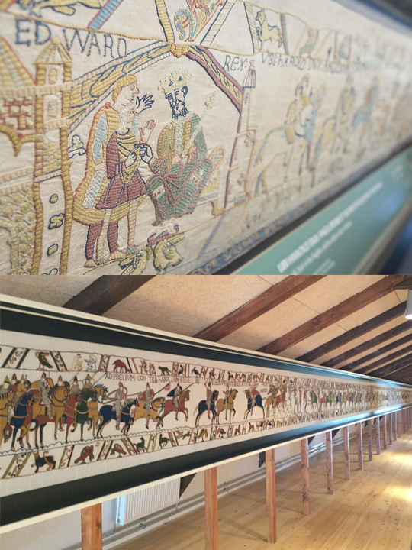
Bayeux Tapestry
The Bayeux Tapestry is a hand-crafted embroidery measuring 70 metres long, made in the 11th century and is listed by UNESCO as a “memory of the world”

